Slide 1
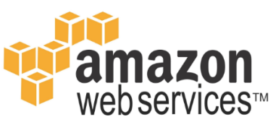
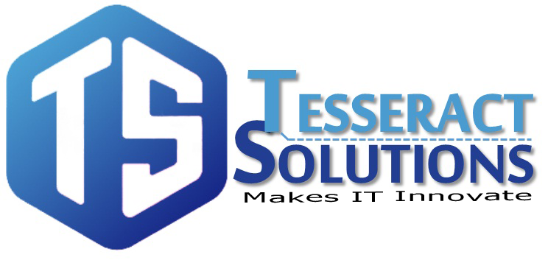
https://www.facebook.com/tesseractspl
https://www.linkedin.com/company-beta/11222535/

Slide 2
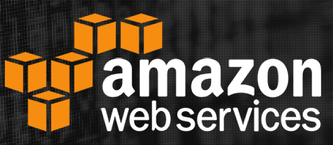
Introduction to AWS Services

Slide 3
AGENDA
Introduction to AWS
Different AWS services
AWS Global Infrastructure
AWS regions and availability zones
AWS Edge Locations
Services Need To Know To Become Solution Architect
AWS Services

Slide 4
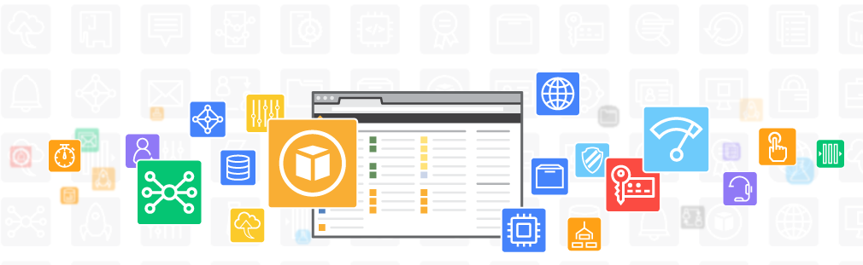
Introduction to AWS
Amazon Web service(AWS) is a secure cloud services platform, offering computer power, database storage, content delivery and other functionality to help business scale and grow.
It provides broad sets of infrastructure services such as computing power, storage options, networking and database, delivered as a utility: on-demand, available in seconds with pay as you go pricing

Slide 5
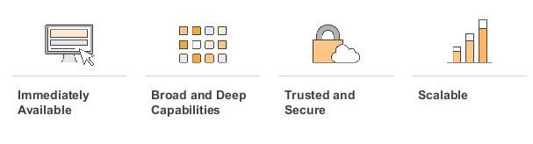
Why AWS???

Slide 6
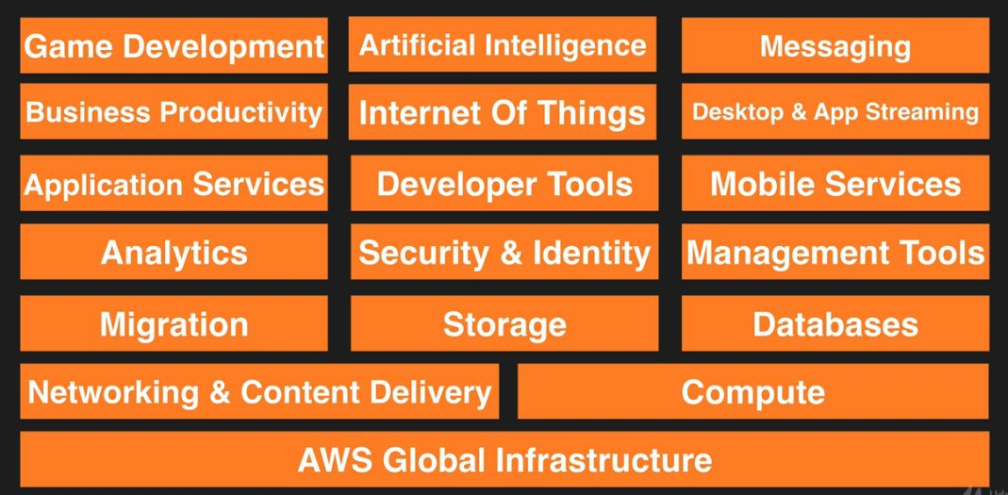
Different AWS Services

Slide 7
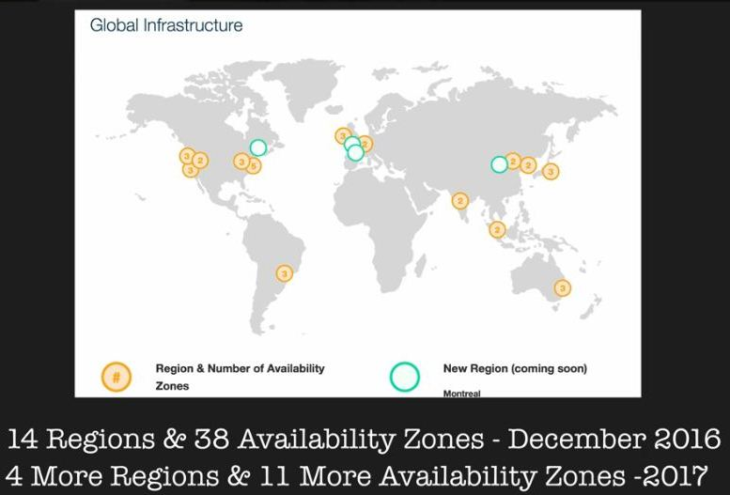
AWS Global Infrastructure

Slide 8
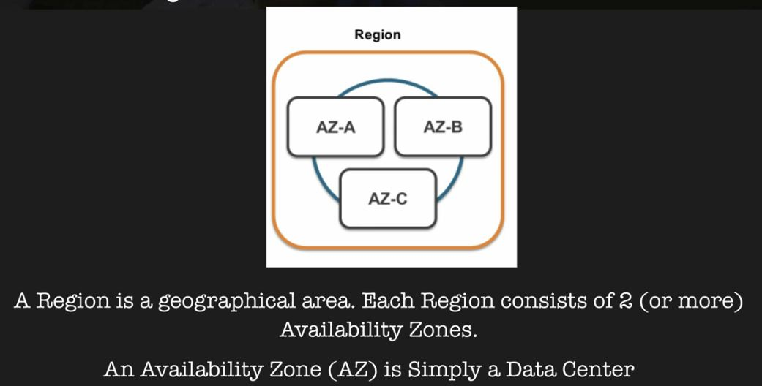
AWS Region and Availability Zone

Slide 9
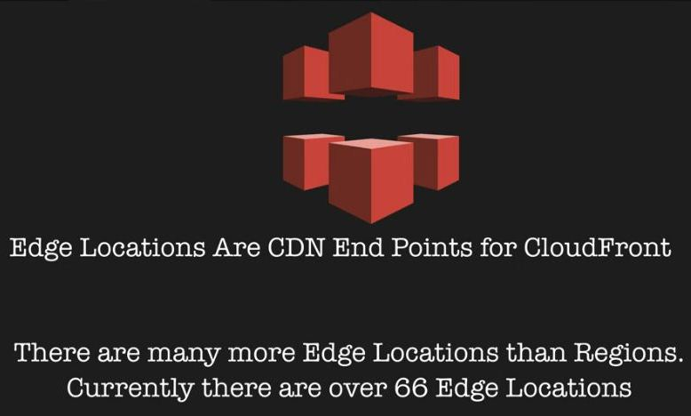
AWS Edge Locations

Slide 10
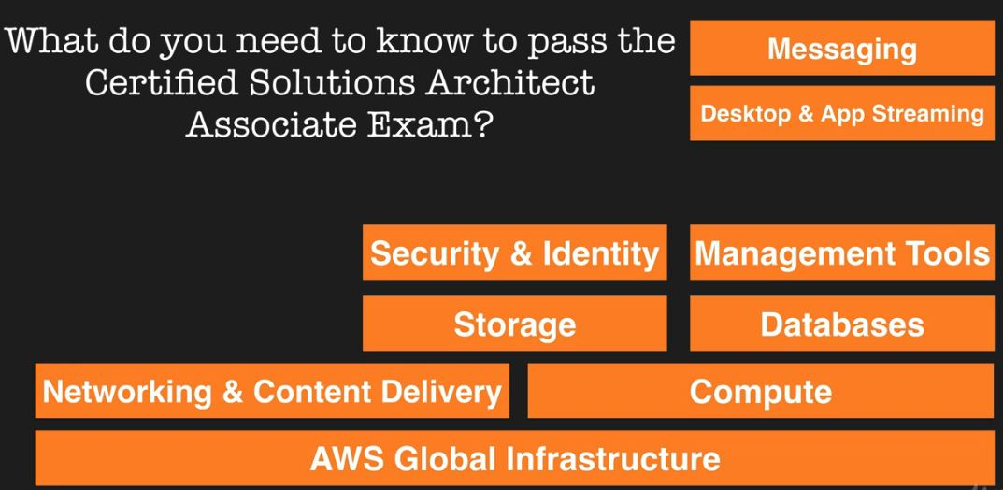
Services Need To Know To Become AWS Solutions Architect

Slide 11
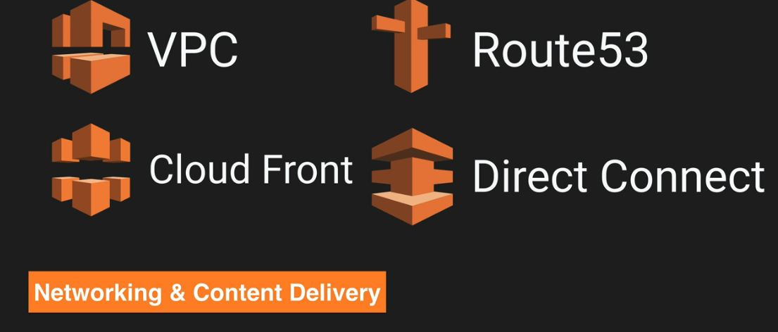
AWS CDN Services
Network And Content Delivery services are the services which allows you to deliver content to your end users with low latency and high transfer speed.

Slide 12
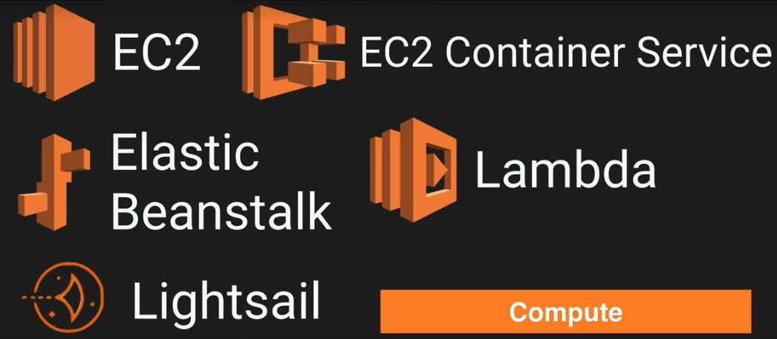
AWS Compute Services
AWS Compute services provides the scalable compute capacity which will help you to grow your business

Slide 13
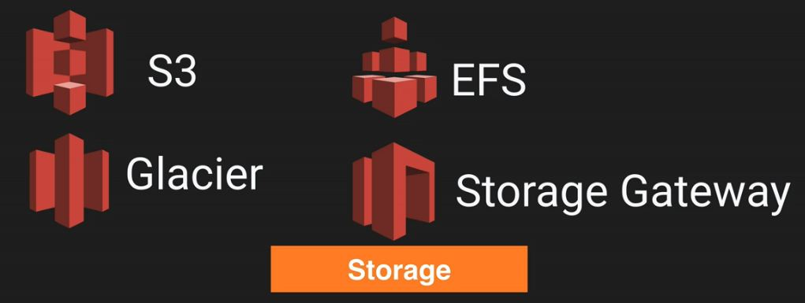
AWS Storage Services
AWS offers a complete range of cloud storage services to support both application and archival compliance requirements. Select from object, file, and block storage services as well as cloud data migration options to start designing the foundation of your cloud IT environment.

Slide 14
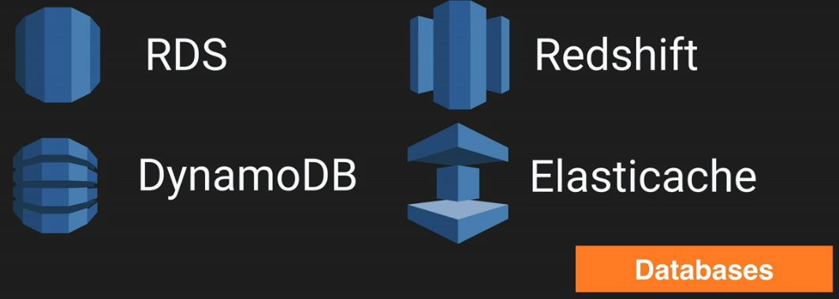
AWS Database Services
Amazon Web Services provides fully managed relational and NoSQL database services, as well as fully managed in-memory caching as a service and a fully managed petabyte-scale data-warehouse service.

Slide 15
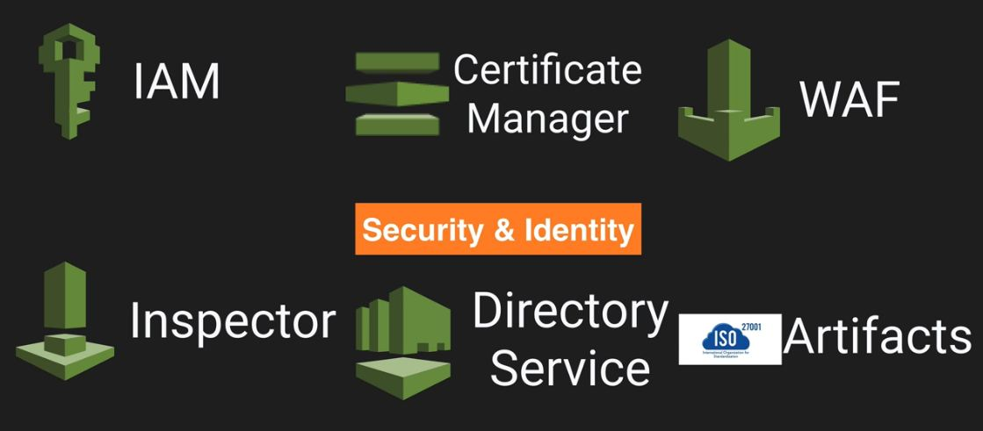
AWS Security & Identity Services
AWS Identity and Access Management (IAM) is a web service that helps you securely control access to AWS resources for your users. You use IAM to control who can use your AWS resources (authentication) and how they can use resources (authorization).

Slide 16
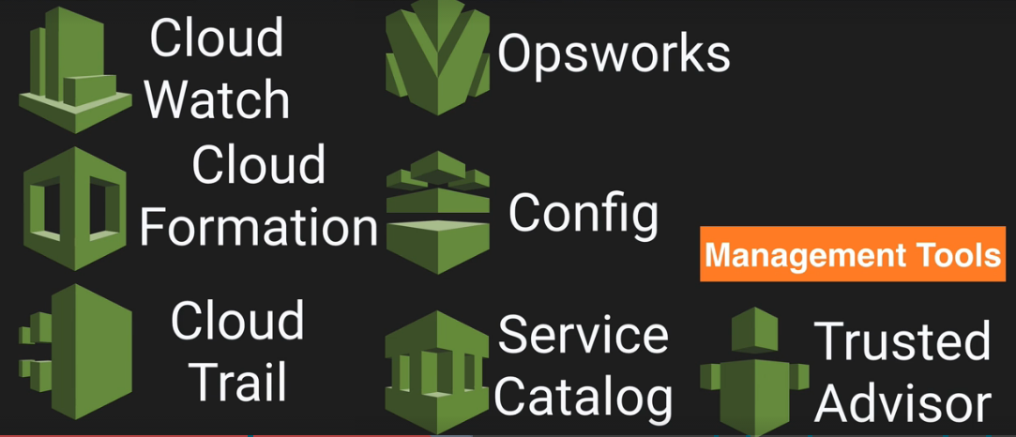
AWS Management Tool Service
AWS Managed Services provides ongoing management of your AWS infrastructure so you can focus on your applications. By implementing best practices to maintain your infrastructure, AWS Managed Services helps to reduce your operational overhead and risk.

Slide 17
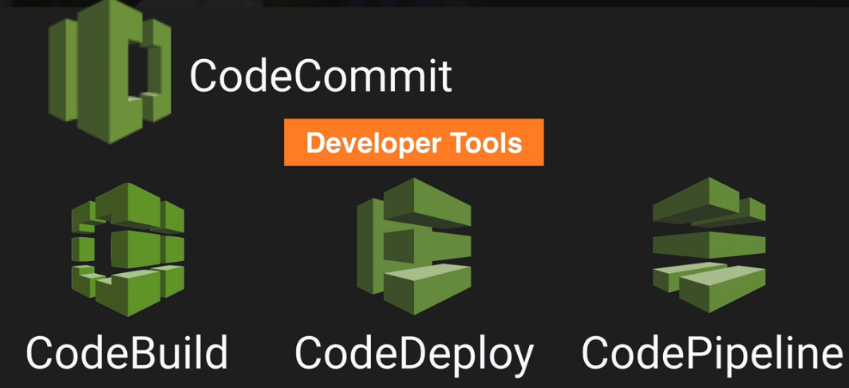
AWS Developer tool Services
The AWS Developer Tools is a set of services designed to enable developers and IT operations professionals practicing DevOps to rapidly and safely deliver software.

Slide 18
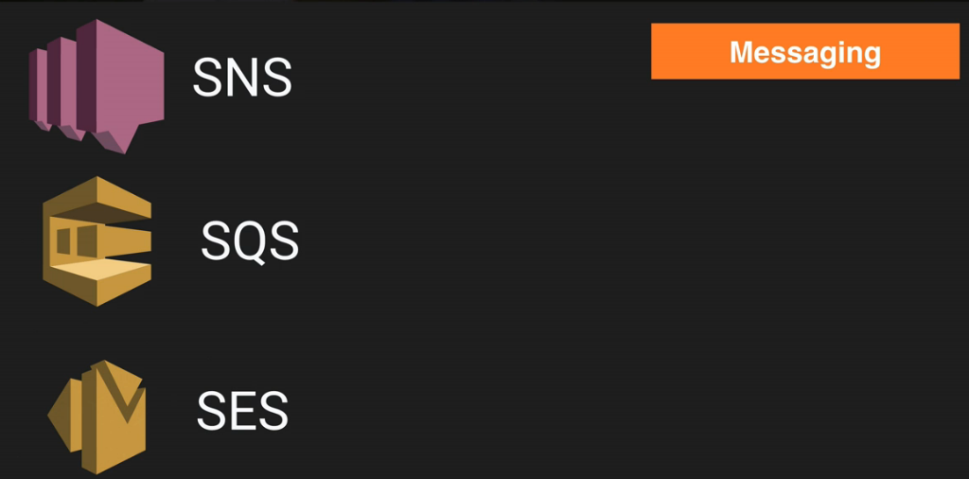
AWS Messaging Services
Messaging services allow software programs to communicate among distributed systems, to isolate resources and interdependencies, and to connect environments with different languages, compilers and operating systems.

Slide 19


Slide 20


